Slide 1
Software engineering (Undergraduate)
Chapter 6 unit testing
Course Name software quality and testing
CSC 4133
(Undergraduate)

Slide 2
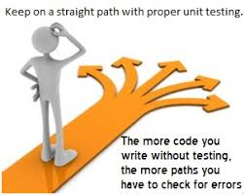
Unit testing
Chapter 6: Unit Testing
MMH
S.2
Tests a small software unit at a time, which is typically performed by the individual programmer who implemented the unit prior to Integration testing
Unit Testing is usually performed by using the White Box Testing method
Lower level/ initial level testing
Static Unit Testing
Dynamic Unit Testing
Static and Dynamic analysis are complementary in nature
It is recommended that static unit testing be performed prior to the dynamic unit testing

Slide 3
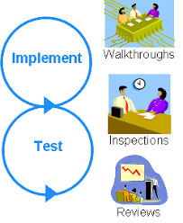
Static Unit testing (review code)
Chapter 6: Unit Testing
MMH
S.3
Code is examined at compile time over all possible behaviors that might arise during run time
Code of each unit is validated against requirements of the unit by reviewing the code
In static unit testing, code is reviewed by applying techniques: - Walkthrough (informal) - Code Inspection (formal)
Black-box and White-box testing

Slide 4
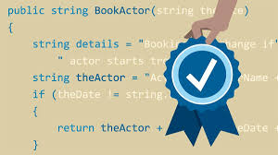
Dynamic Unit testing (execute code)
Chapter 6: Unit Testing
MMH
S.4
Execute at Run time testing of Code
Black-box testing

Slide 5
Steps in the code review process
Chapter 6: Unit Testing
MMH
S.5
Step 1: Readiness – The author of the code unit ensures that the unit under test is ready for review. A unit is said to be ready if it satisfies the following criteria – Completeness, Minimal functionality, Readability, Complexity, Requirements and Design documents
Step 2: Preparation – Each reviewer develops the following: List of questions, Potential Change Request (CR), Suggested improvement opportunities
Step 3: Examination – the examination process consists of the following:
The author makes a presentation
The reviewer reads the code
The record keeper documents the CR
Moderator ensures the review is on track
CR (Change Request) includes the following details:
Give a brief description of the issue
Assign a priority level (major or minor) to a CR
Assign a person to follow it up
Set a deadline for addressing a CR

Slide 6
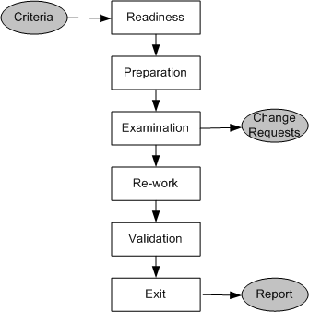
Steps in the code review process
Chapter 6: Unit Testing
MMH
S.6
Step 4: Re-work – At the end of the meeting, the record keeper produces a summary of the meeting that includes the following information:
Make the list of all the CRs
Make a list of improvements/maintenance (corrective, perfective, adaptive, preventive maintenance)
Record the minutes of the meeting (optional)
Author works on the CRs to fix the issue
Step 5: Validation
CRs are independently validated (e.g. regression testing)
Step 6: Exit
A summary report of the meeting minutes is distributed among the stakeholder who have requested and who will affected by the changes

Slide 7
code review metrics
Chapter 6: Unit Testing
MMH
S.7
Identify the Cost of Development and Change
Cost may calculate by How many lines the developer can write in each hour and How much money to pay him for each hour that finds out the cost of each line of code
The number of lines of code (LOC) reviewed per hour
The number of CRs generated per thousand lines of code (KLOC)
Identify the Cost of Testing process
Number of CRs generated per hour
The total number of hours spend on code review process

Slide 8
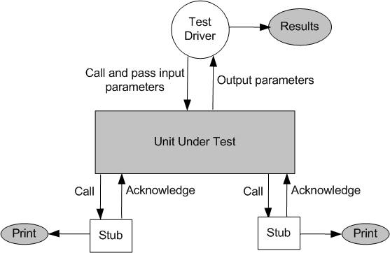
Dynamic unit testing
Chapter 6: Unit Testing
MMH
S.8
Execution-based unit testing is referred to as dynamic unit testing
A program unit is executed in isolation, and the outcomes of program execution are observed
The environment of a unit is emulated and tested in isolation
IDE checks every statement in the program for errors while writing
The caller unit is known as test driver
A test driver is a program that invokes the unit under test (UUT)
It provides input data to UUT and report the test result
The emulation of the units called by the UUT are called stubs
It is a “sub-program” that replaces a unit that is called by the UUT
The test driver and the stubs are together called scaffolding
The low-level design document provides guidance for selection of input test data
Figure : Dynamic unit test environment

Slide 9
Dynamic unit testing
Chapter 6: Unit Testing
MMH
S.9
Control flow testing
Draw a control flow graph (CFG) from a program unit and Select a few control flow testing criteria
Identify a path in the CFG to satisfy the selection criteria
Derive the path predicate expression from the selection paths and one can generate the data
Data flow testing
Draw a data flow graph (DFG) from a program unit and then follow the procedure described in control flow testing (e.g. marks conversion and grading in VUES)
Domain testing
A domain error occurs when a specific input data causes the program to execute a wrong path in the program (e.g. Leave application: for1-5 days recommendation by team lead, 5-10 by PM)
Functional program testing
Input/output domains are defined to compute the input values that will cause the unit to produce expected output values (e.g. grading in VUES A+ for 90 marks)

Slide 10

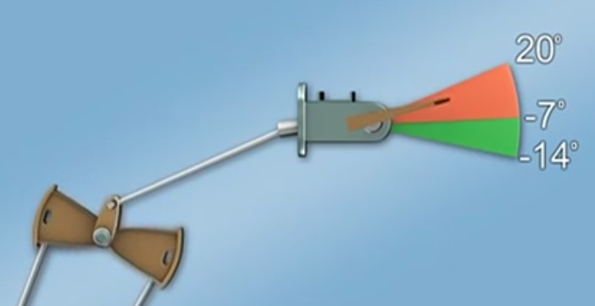

Debugging
Chapter 6: Unit Testing
S.10
MMH
Debugging Identify the error and potential cause of error (hypothetical hidden errors)

Slide 11
Debugging techniques
Chapter 6: Unit Testing
S.11
MMH
Identify the error and potential cause of error (hypothetical hidden errors)
Brute force testing
most common; but least efficient
memory dumps are taken, run-time traces are invoked, and the program is loaded with output statements
Backtracking
common debugging approach that can be used successfully in small programs
source code is traced backward (manually) until the cause is found
Cause elimination
a “cause hypothesis” is devised
if initial tests indicate that a particular cause hypothesis shows promise, data are refined in an attempt to isolate the bug (c/a-b where the possibility of a-b is zero)

Slide 12
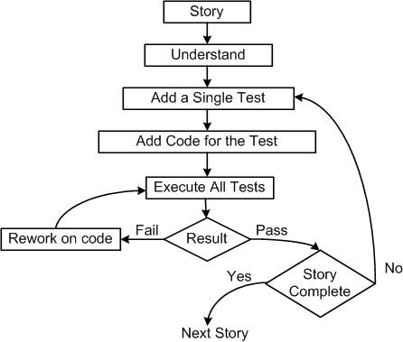
Unit Testing in extreme Programming
Chapter 6: Unit Testing
S.12
MMH
Pair programming in XP
1. Pick a requirement (i.e. story)
2. Write a test case that will verify a small part of the story and assign a fail verdict to it
3. Write the code that implement particular part of the story to pass the test
4. Execute all tests
5. Rework on the code, and test the code until all tests pass
6. Repeat step 2 to step 5 until the story is fully implemented

Slide 13
Unit testing
Chapter 6: Unit Testing
S.13
MMH
A mutation of a program is a modification of the program created by introducing a single, small, legal syntactic change in the code.
Junit is a framework for performing unit testing of Java programs.

Slide 14
Tools for Unit Testing
Chapter 6: Unit Testing
S.14
MMH
Test harness
Performance monitors
Network analyzers
Simulators and emulators
Version control
Code auditor
Documenters
Interactive debuggers
Static code (path) analyzer
Software inspection support
Test coverage analyzer
Test data generator

Slide 15
references
Chapter 6: Unit Testing
S.15
MMH
Software Testing And Quality Assurance – Theory and Practice - Kshirasagar Naik & Priyadarshi Tripathy
Software Quality Engineering: Testing, Quality Assurance and Quantifiable Improvement - Jeff Tian

